Slide 1
Scientific Computing Project
by Sai Pavan Kumar Yedduri and Intekhab Alam

Slide 2
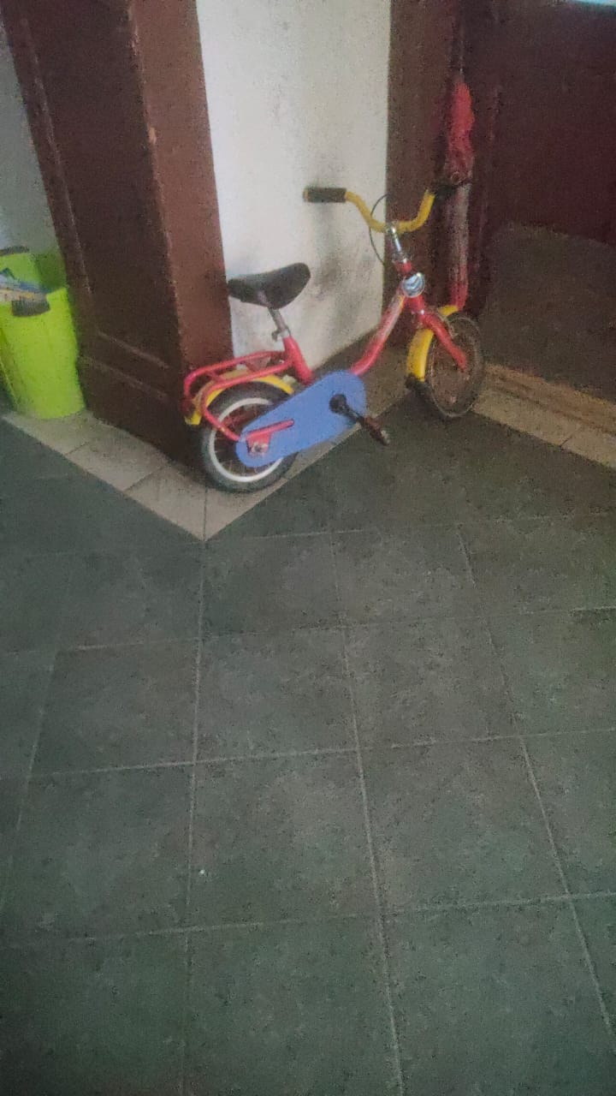
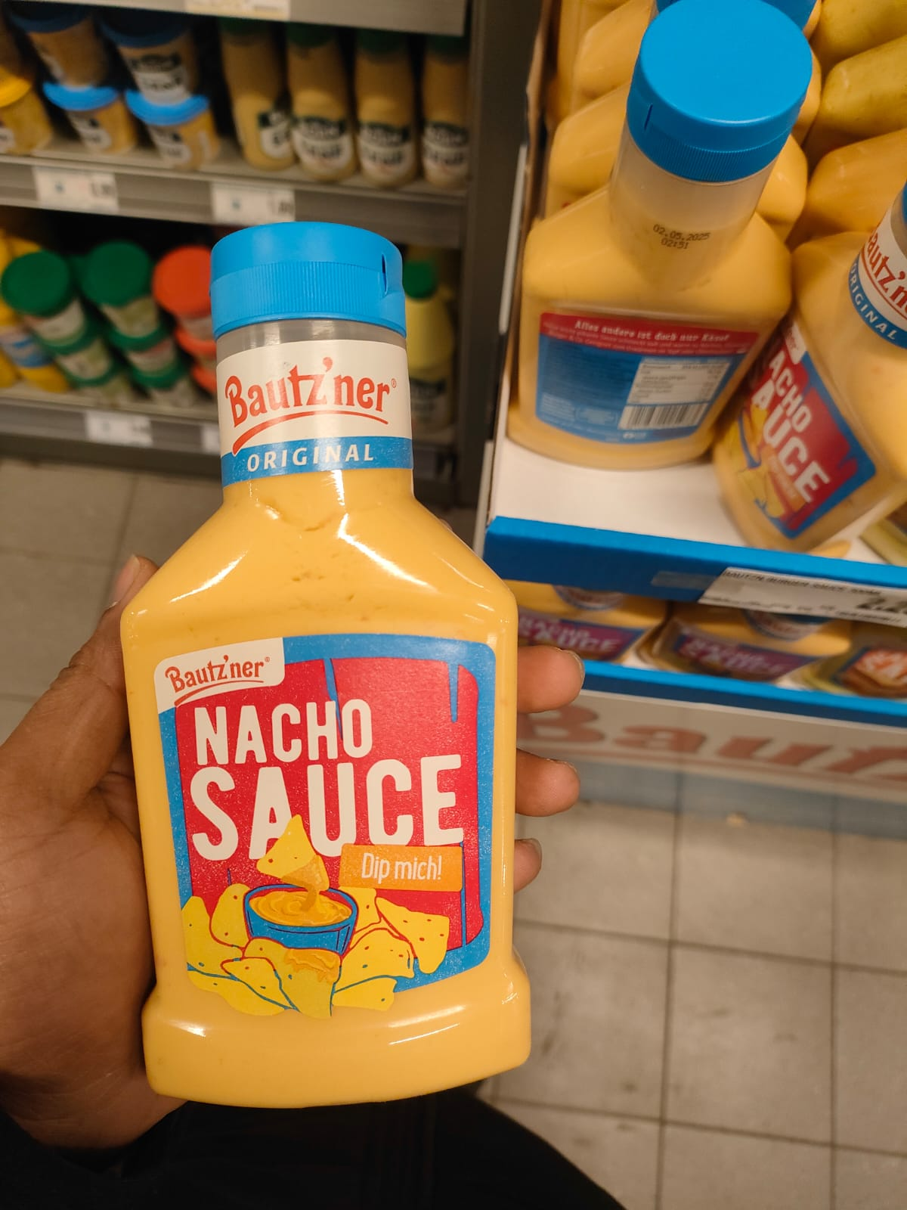
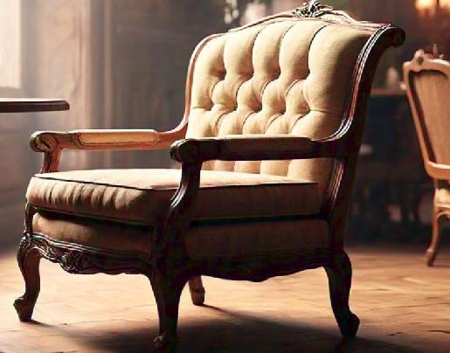
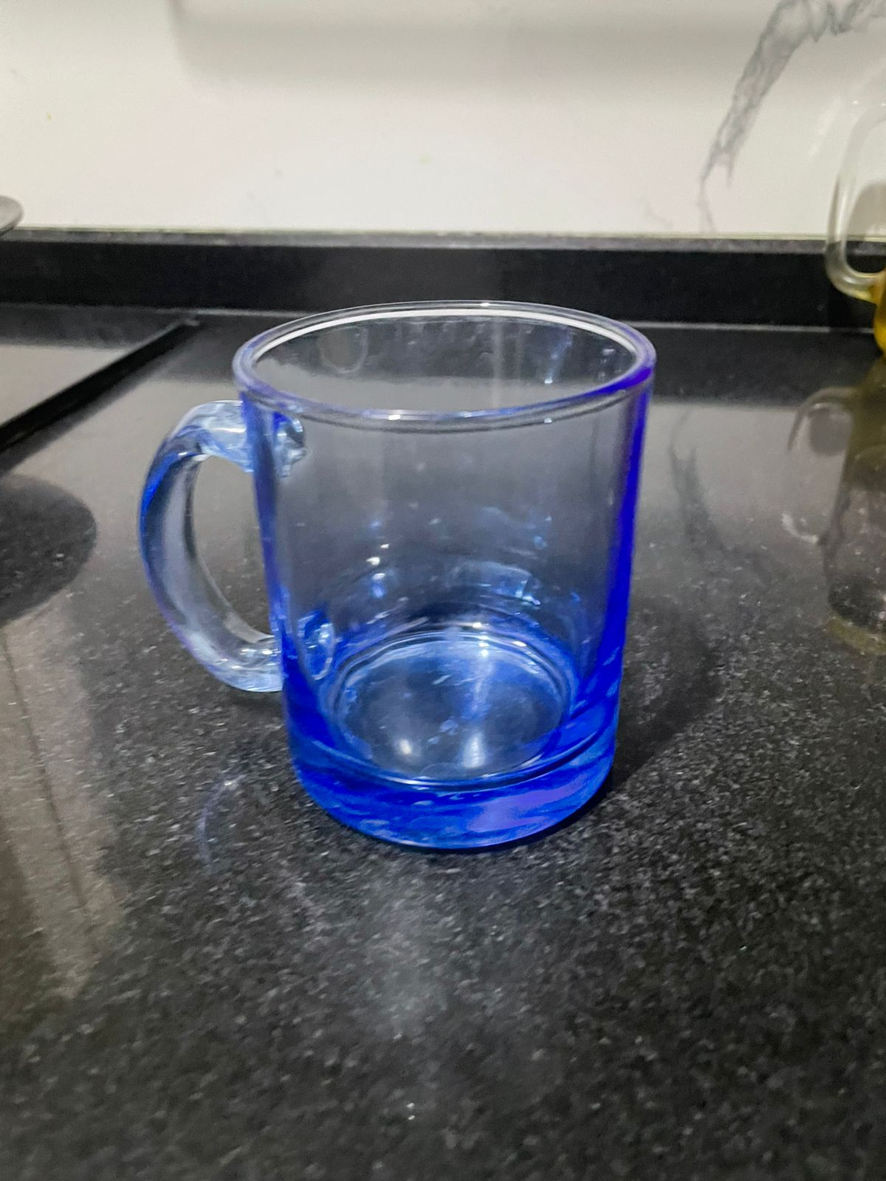

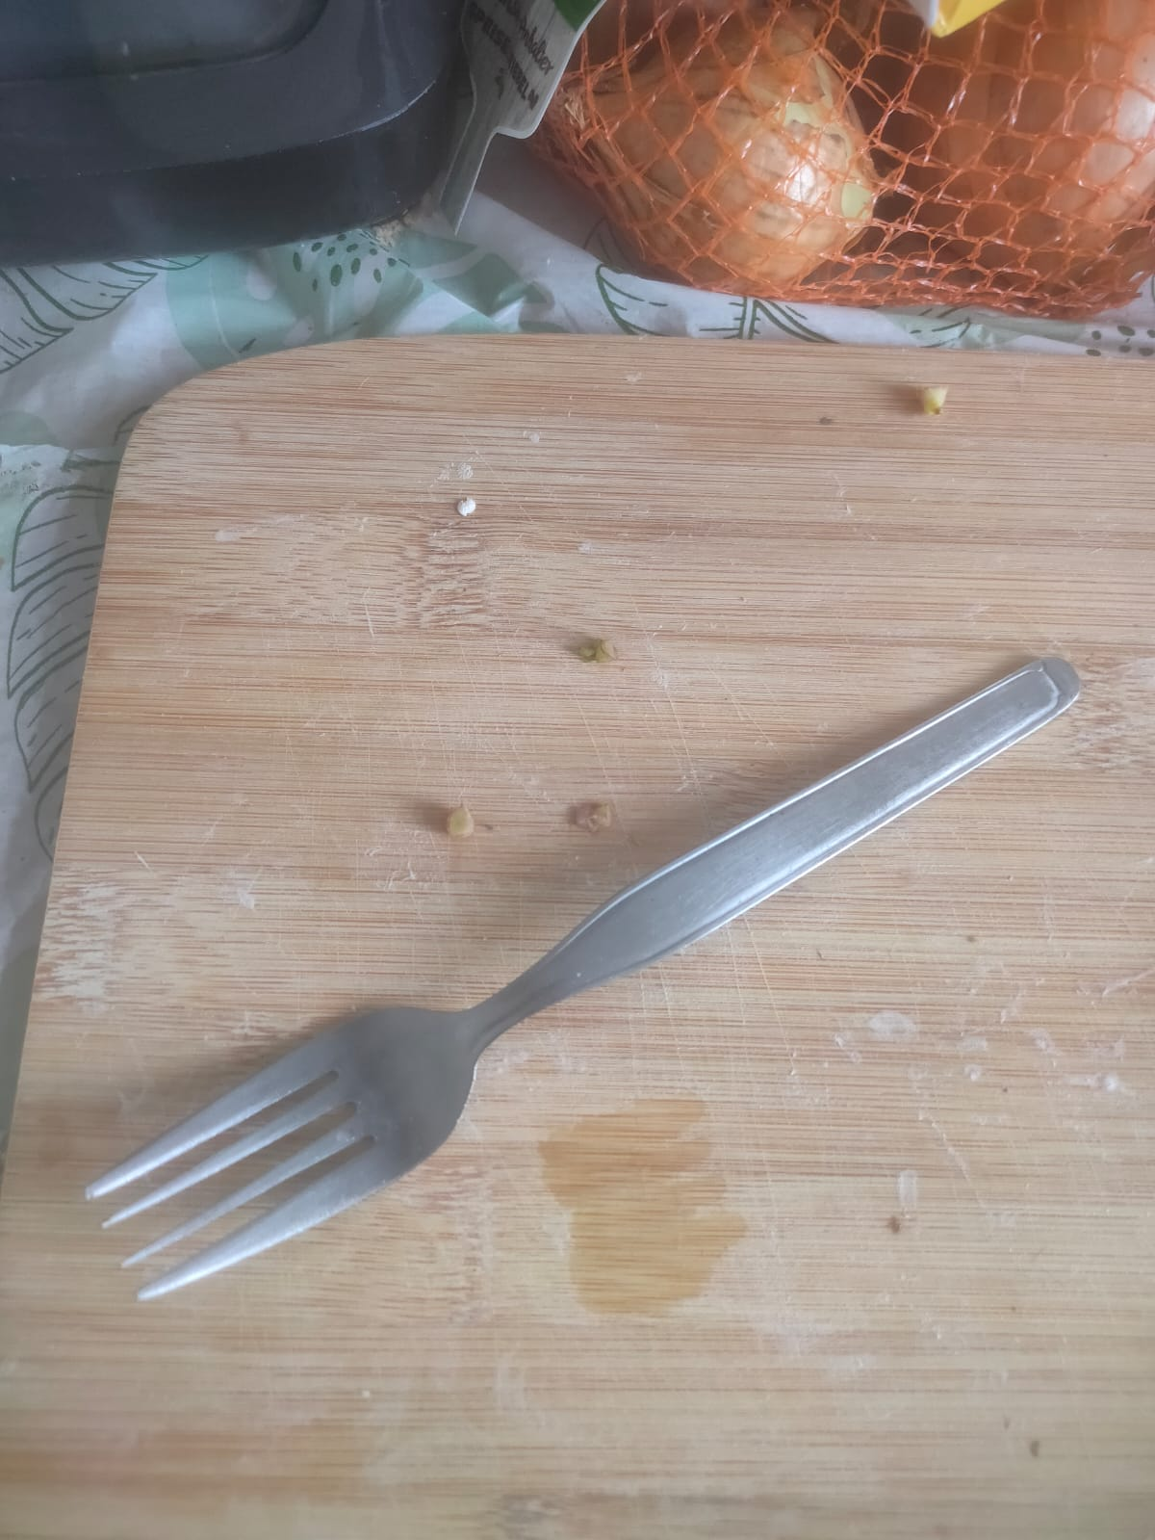
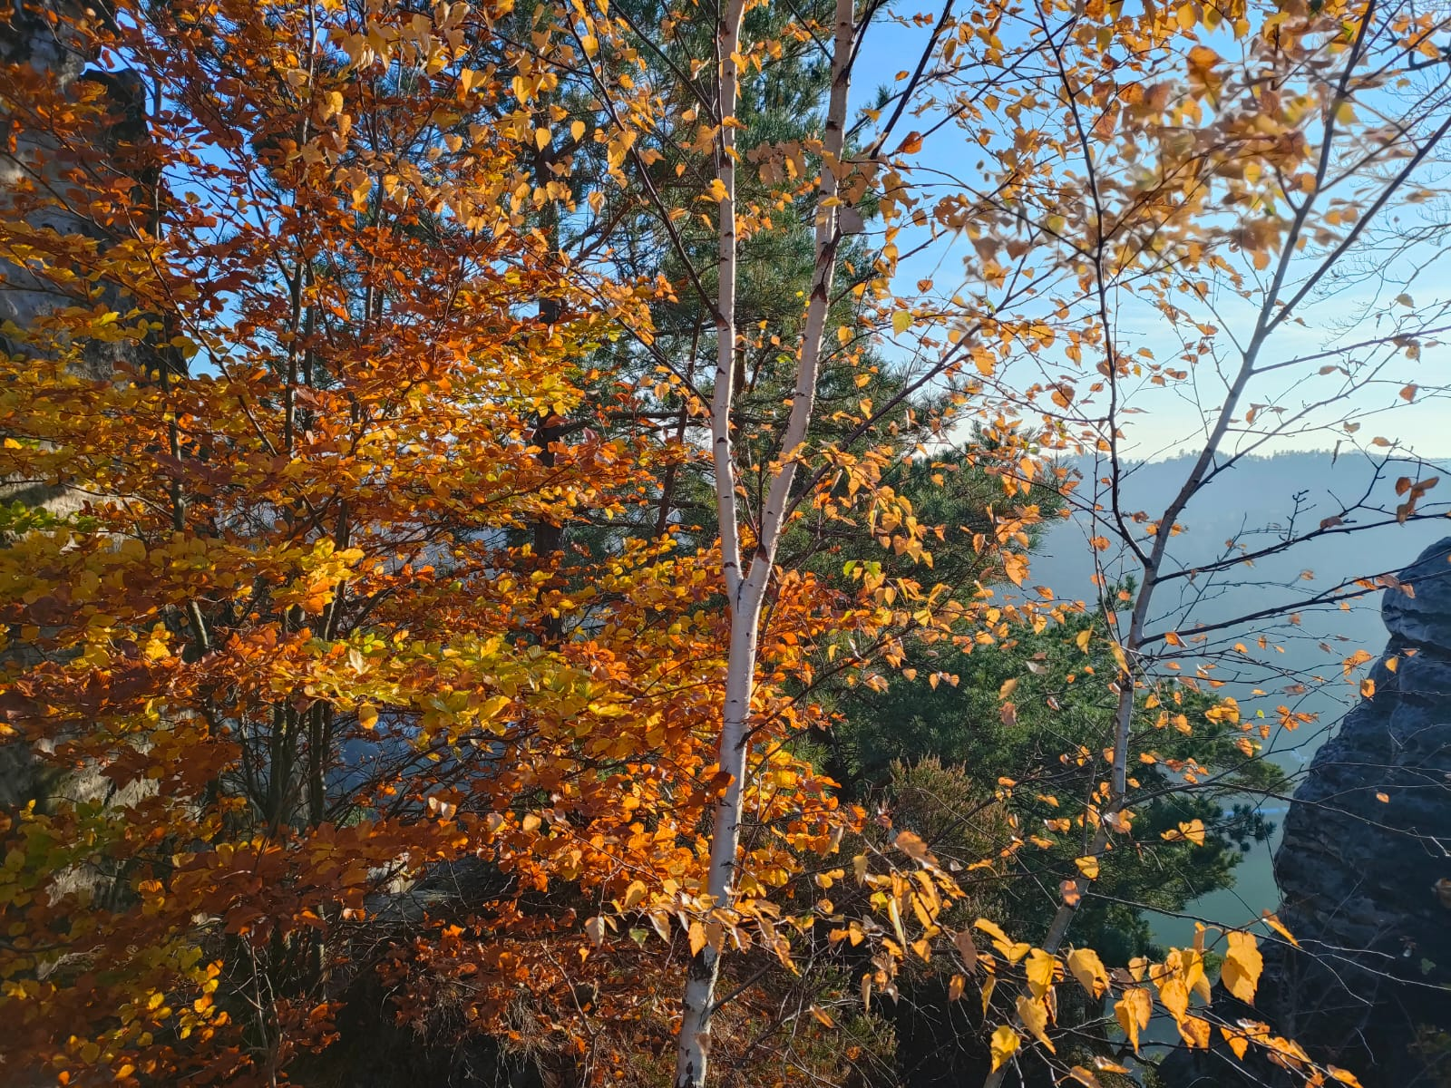

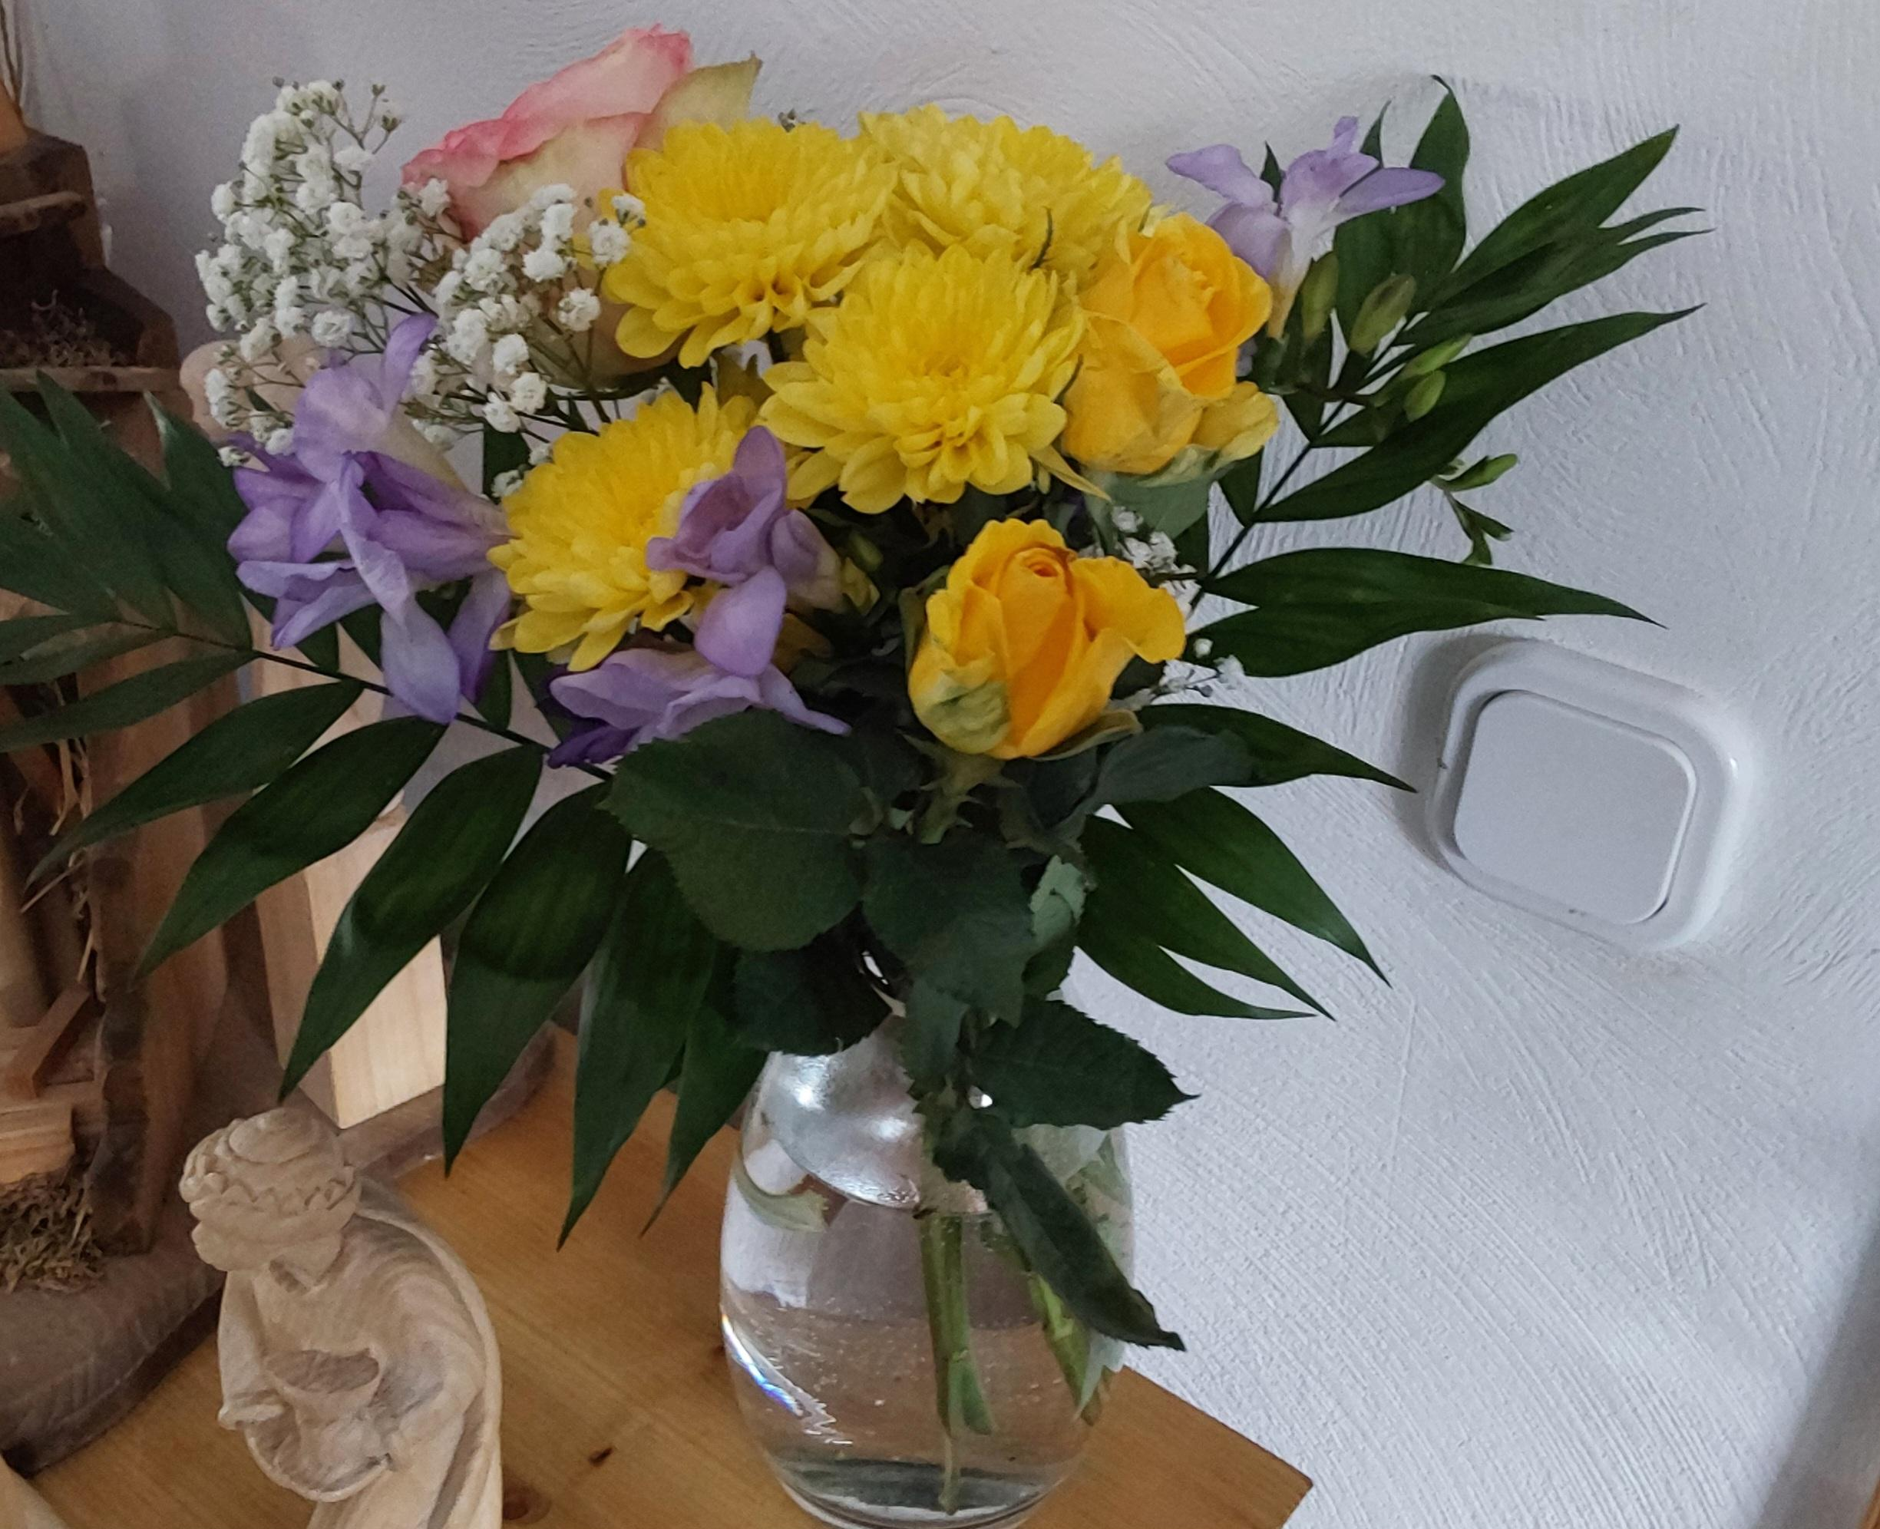
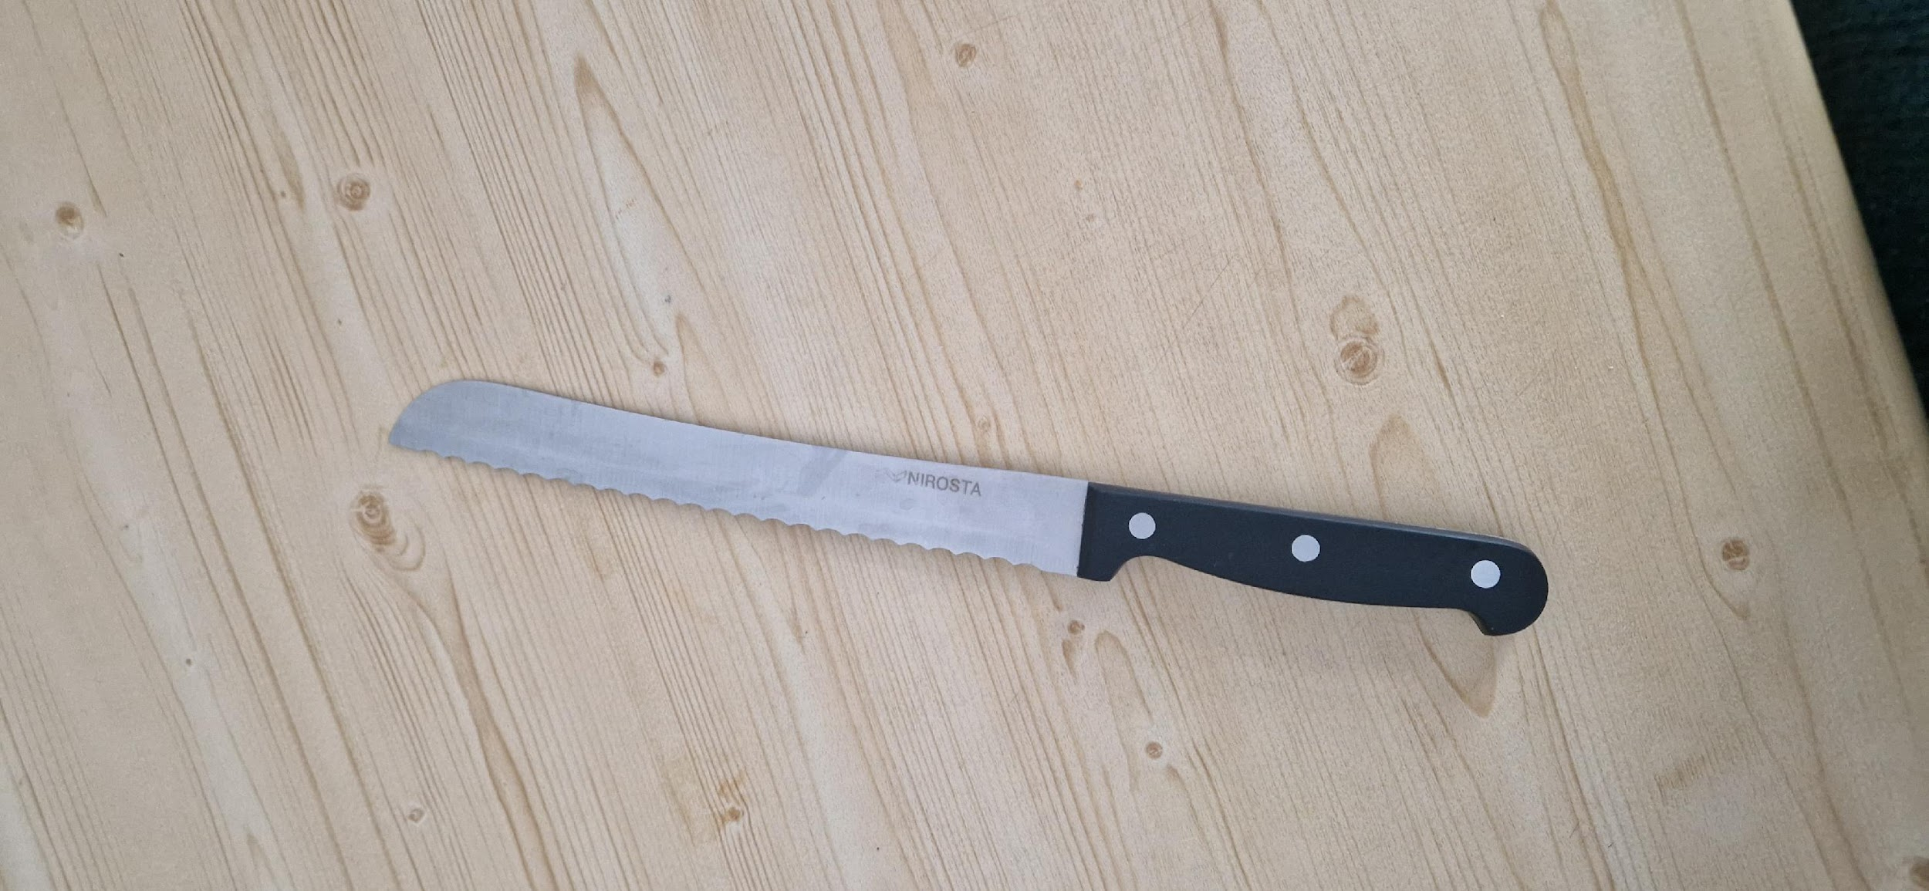
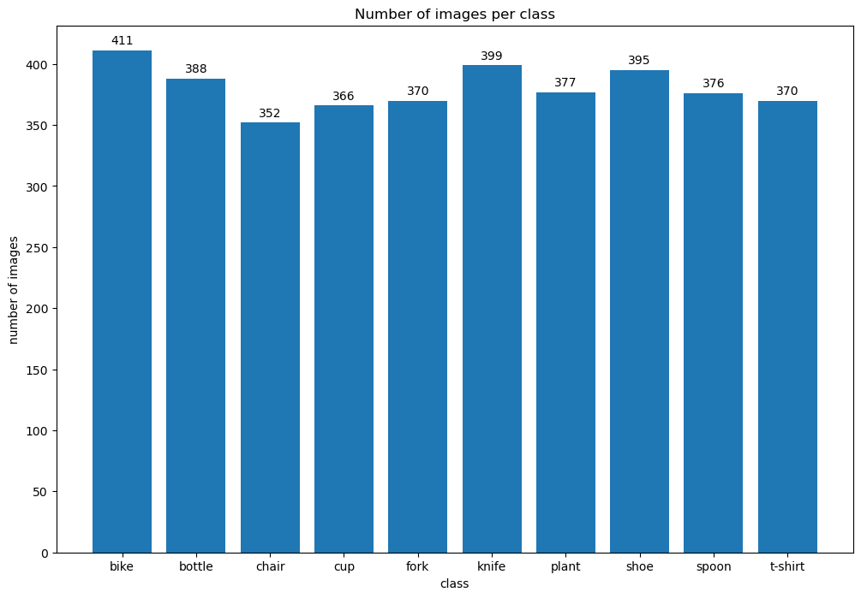
Captured Dataset
Captured 10 categories of real-world images comprising of bike, bottle, chair, cup, fork, knife, plant, shoe, spoon and t-shirt.
Images are Independent and Identically distributed as they were captured across different categories from various perspectives, orientations, height, width, and resolution.
Captured Dataset consist of 3,804 images with near-uniform class distribution to prevent class imbalance issues during classification.
The mean and standard deviation of the collected tensor images is (0.52,0.48,0.43) and (0.22,0.22,0.22) respectively.
Figure: Randomly selected images from the captured dataset
Figure: class distribution of images of captured dataset

Slide 3
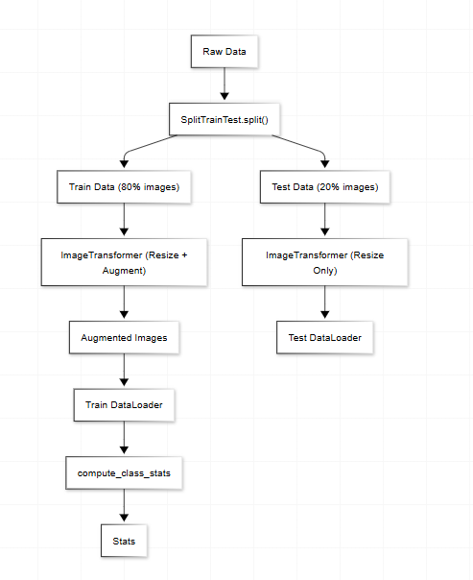
Preprocessing: Preparation of Augmented Dataset
Initially, each class of the captured dataset was split into train data(80%) and test data(20%).
All images are resized to (224, 224) to ensure good balance between feature extraction and computational efficiency.
Further, captured training image database is augmented through a set of random transformations(horizontal, ±30 degrees rotation , color variations) to increase the data as well as increase the randomness in the images.
Finally, images are converted to tensors with more than 3 dimensions, as deep learning models(like Resnet -50) categorize images into (No. batches, No. of channels, Height of image, Width of image).
Images are loaded and transformed through batch loading of images to save computational memory in various systems.
Figure: Flowchart indicating the steps for preparation of augmented train data and test data

Slide 4
Preprocessing: Dataset
Training Data
Resize to 256 pixels to maintain aspect ratio
Center crop 224 × 224
Random horizontal flip
Random rotation (±30°)
Color Jitter: Brightness: ±0.2, Contrast: ±0.2,
Saturation: ±0.2, Hue: ±0.1
Convert to Tensor
Test Data
Resize to 256
Center Crop to 224 x 224
Convert to Tensor

Slide 5
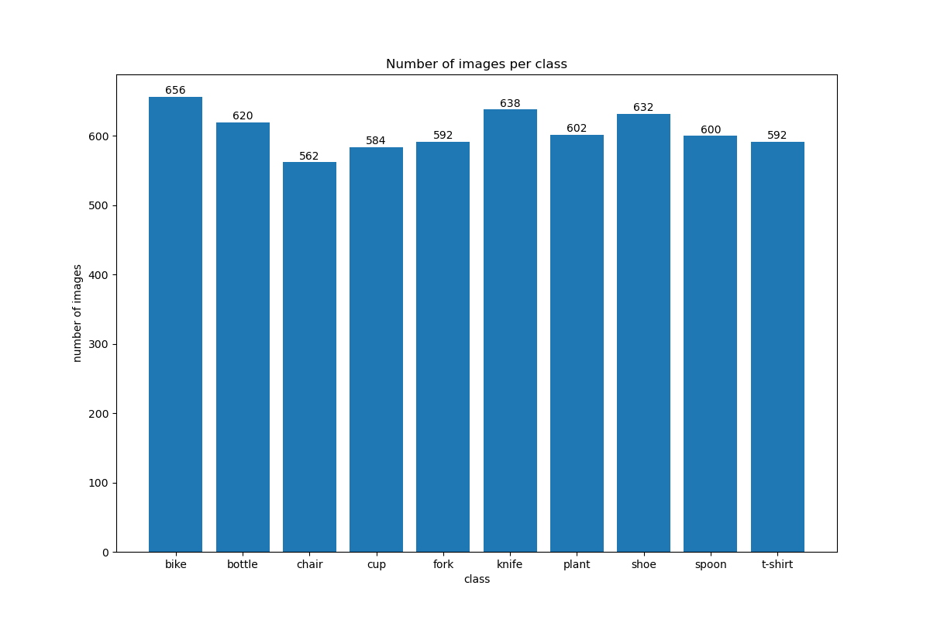
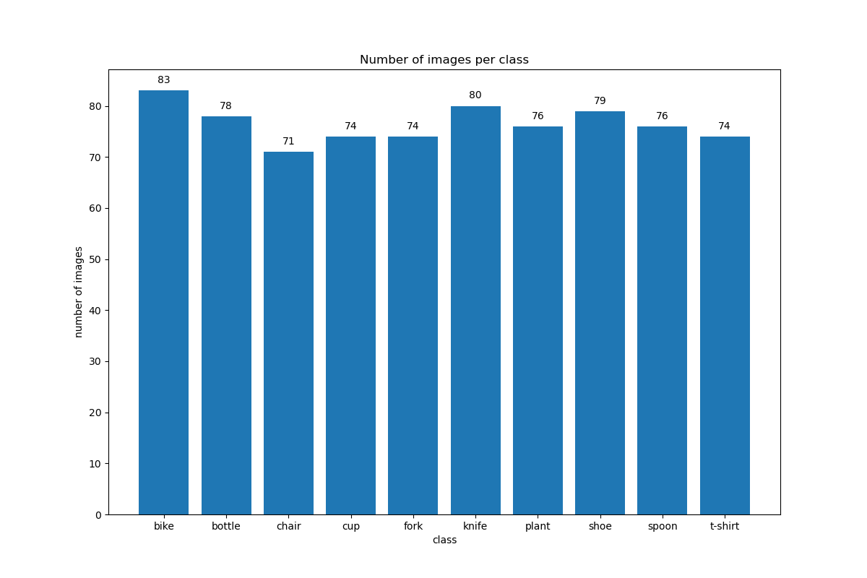
Preprocessing: Computed Statistics of Augmented Dataset
Metric | Before augmentation of resized-tensor images | After split and Augmentation of train data of tensor images
Number of Images | 3,804 images | 6,078 (original images with augmented image data) + 765(test data) =6843 images
Mean (R, G, B) | (0.5285, 0.4851, 0.4376) | (0.4533, 0.4218, 0.3897)
Std (R, G, B) | (0.2285, 0.2215, 0.2254) | (0.2638, 0.2574, 0.2470)
Min (R, G, B) | (0,0,0) | (0,0,0)
Max (R, G, B) | (1,1,1) | (1,1,1)
Figure: Comparison of the class distribution of images between augmented train data (on top)
and test data (at the bottom)

Slide 6


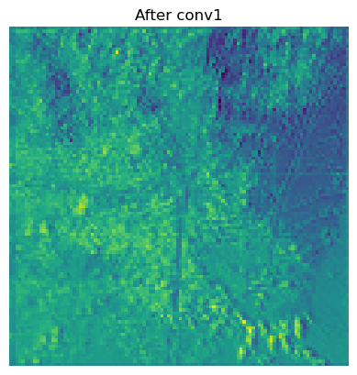

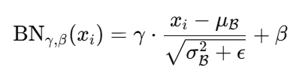
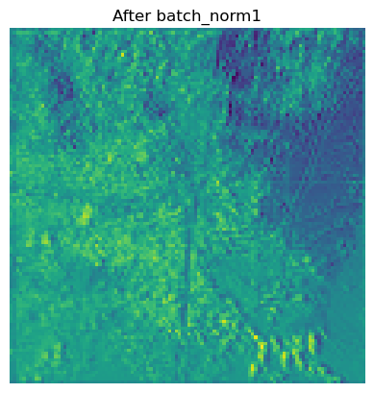
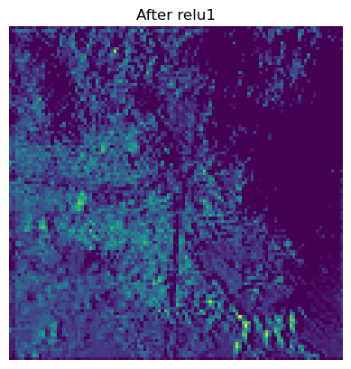
Construction of simple convolutional layer
7×7 Convolution: Each image(3×224×224 for RGB image) is passed over the 7x7 kernel(where weights are generated through He initialization) with a stride of 2 and padding 3 would result in (64,112,112).
The output shapes of the feature map were computed based on the input size 224, 7x7 kernel, padding 3 and stride 2 using following convolution output size equation. Thereby resulting a kernel 112x112.
Batch Normalization: After the 7x7 convolution, an initial batch normalization is performed to stabilize the training and improve the convergence.
Rectified Linear Unit (ReLU) activation: After each convolution, the ReLU activation is applied to introduce non-linearity in the feature maps. Also, such activation function would help in overcoming vanishing gradient descent problem during optimization.
Input Image
7x7 Convolution1
Equation: Equation for computing output size of the image after convolution
BatchNormalization1
ReLU1
Figure : Flowchart indicating transformation of images during single convolutional layer of Bottleneck block after each step of convolution layer (Convolution1, Batch Normalization, ReLU). The images show only the first feature map of the first channel after each operation step to simplify the visualization.

Slide 7
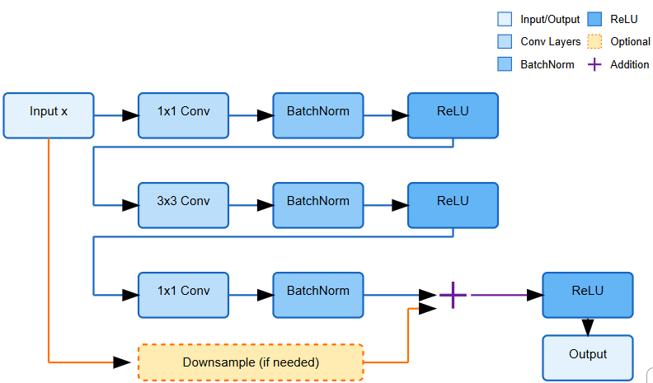
Idea of Residual Neural Network-50
Problem: While training deep neural networks, the gradients at deeper layers of neural network diminish during back propagation preventing effective weight updates. This makes deep neural network very difficult to learn and increase accuracy beyond a certain depth[1,2].
Idea: After every 3 convolutional layers of CNN, the untransformed image can be superimposed onto the transformed feature map of images, thereby increasing the pixel values of transformed image for next batch of operations[3]
The addition of image over the transformed image is called identity mapping
H(x) = F(x) + x
Advantage: The identity mapping acts as shortcut connection maintaining constant error H(x)-x between ‘x’(untransformed image before 3 convolutional layers) and transformed feature map of the image H(x) for every 3 convolutional layers throughout the deep neural network.
error = H(x) – x = constant
Figure: Architecture of the implemented Bottleneck Residual Block in ResNet-50, illustrating the three convolutional layers along with batch normalization and RELU transformation

Slide 8
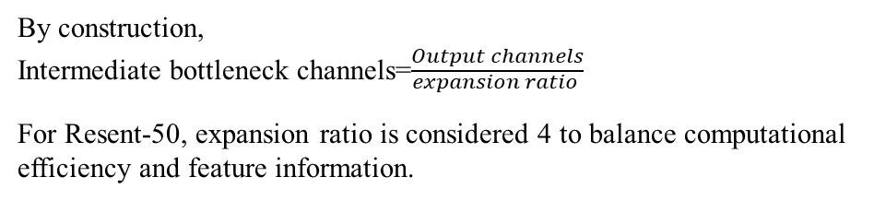
Construction of Bottleneck Block-Building blocks
1×1 Convolution (Dimensionality Reduction): Before performing expensive 3x3 convolution operation, the number of channels are reduced to intermediate bottleneck channels, except for first residual layer to preserve initial features.
1x1 Conv: (B, 256, H/4, W/4) → (B, 128, H/4, W/4)
3×3 Convolution (Feature Transformation): The layer extracts rich features from the reduced-dimensional representation for learning complex patterns. The spatial resolution(height and width) are reduced by half with stride 2.
3x3 Conv (stride=2): (B, 128, H/4, W/4) → (B, 128, H/8, W/8)
3) 1×1 Convolution (Dimensionality Restoration): The final layer increases the bottleneck channels by bottle neck ratio (considered 4 for Resnet-50).
1x1 Conv: (B, 128, H/8, W/8) → (B, 512, H/8, W/8)
Figure: Architecture of the implemented Bottleneck Residual Block in ResNet-50, illustrating the three convolutional layers along with batch normalization and RELU transformation

Slide 9
Construction of residual layers in ResNet-50
ResNet-50 consists of four residual layers, with each considering different number of bottleneck blocks i.e;3,4,6 and 3 bottleneck blocks respectively.
The 1st bottleneck block in each residual layer expands number of channels as input ≠ output channels and the next bottlenecks maintain those number of channels, while still learning deeper and more abstract representations of data.
In residual layer2, 2nd Bottleneck Block:
Input: (512, 28, 28)
1×1 Conv: 512 channels → 128 channels
3×3 Conv: 128 channels→ 128 channels
1×1 Conv: 128 channels→ 512 channels
Add skip connection (identity)
Output: (512, 56, 56)
The output of the bottleneck blocks are stacked into the residual layers.
Residual Layers | Input Feature Map | Transformation in 1st Bottleneck Block | Output Feature Map
Residual Layer 1 (3 Bottleneck Blocks) | (64, 56, 56) | 1×1 Conv (64 → 64) → 3×3 Conv (64 → 64) → 1×1 Conv (64 → 256) | (256, 56, 56)
Residual Layer 2 (4 Bottleneck Blocks) | (256, 56, 56) | 1×1 Conv (256 → 128) → 3×3 Conv (128 → 128) → 1×1 Conv (128 → 512) | (512, 28, 28)
Residual Layer3 (6 Bottleneck Blocks) | (512, 28, 28) | 1×1 Conv (512 → 256) → 3×3 Conv (256 → 256) → 1×1 Conv (256 → 1024) | (1024, 14, 14)
Residual Layer 4 (3 Bottleneck Blocks) | (1024, 14, 14) | 1×1 Conv (1024 →512) →3×3 Conv (512 →512) → 1×1 Conv (512 →2048) | (2048, 7, 7)
Table: Table indicating the transformations of channels in each residual layer along with the input and output feature maps

Slide 10
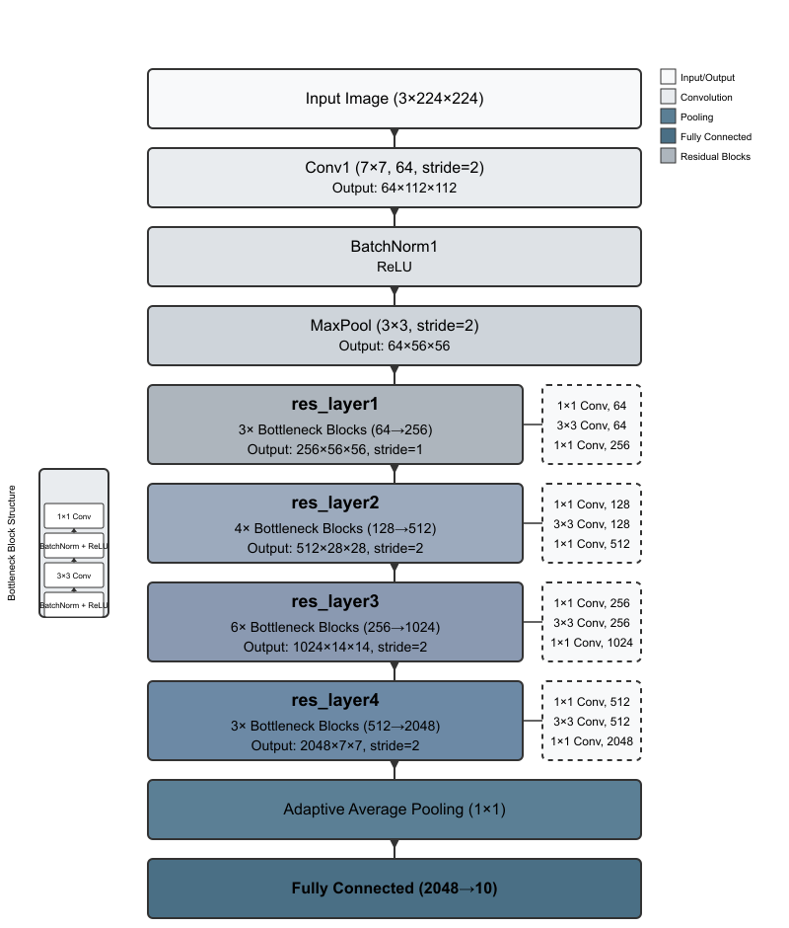
Workflow of Resnet-50
Before diving into residual layers, ResNet-50 begins with standard convolutional processing:
Initial convolution & max pooling layers:
a. 7x7 Convolution layer: Extract low level features of the image by detecting low-level features(edges and textures) after batch normalization and non-linear ReLU activation.
b. Maxpooling: Reduces the size of feature maps while keeping the no. channels same by selecting the maximum value of sliding window from the feature map.
2. Forward Propagation through Residual Layers:
1st bottleneck of each residual later performs downsampling using stride 2.
Remaining blocks preserve spatial dimension and refines the features. The identity mapping stabilizes the gradient flow.
3. Final Average Pooling and Fully Connected Layers:
a. Adaptive Average Pooling: Reduces the tensor and averages each channels 7x7 map into single number in 2048 channels.
b. Fully Connected Layer: Converts 2048-dimensional feature vector into class scores(logits) through weighed sum of the feature maps with weights size: (no. of classes, 2048 channels).
Figure: Flowchart indicating the operation steps of Residual Neural Networks-50

Slide 11
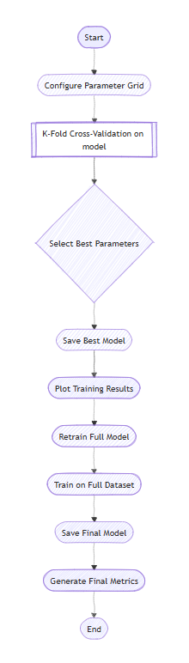


Training of ResNet-50 CNN on Image database
Purpose of Training: To learn the optimal weights and parameters of the model, which performs well on unseen data.
To find the best weights of the model for the unseen data, the model is trained on major subsets of the training data called “training fold” and at the same time test the evaluate the model on the minor subset of training data called “validation fold” on specified number epochs.
To find the best parameters, this process of “k-fold cross validation” is trained on different parameters of the search space during hyperparametertuning.
Resnet-50 model is further retrained on full training data with the best hyperparameters to obtain optimal weights.
A model training pipeline, as in the figure, is designed to automate the data preprocessing, hyperparameter tuning and generate plot results.
Since the images are categorized into 10 classes, the cross-entropy loss for multi-label classification using logits( )is:
Figure: Flowchart of Model Training Pipeline Implemented

Slide 12
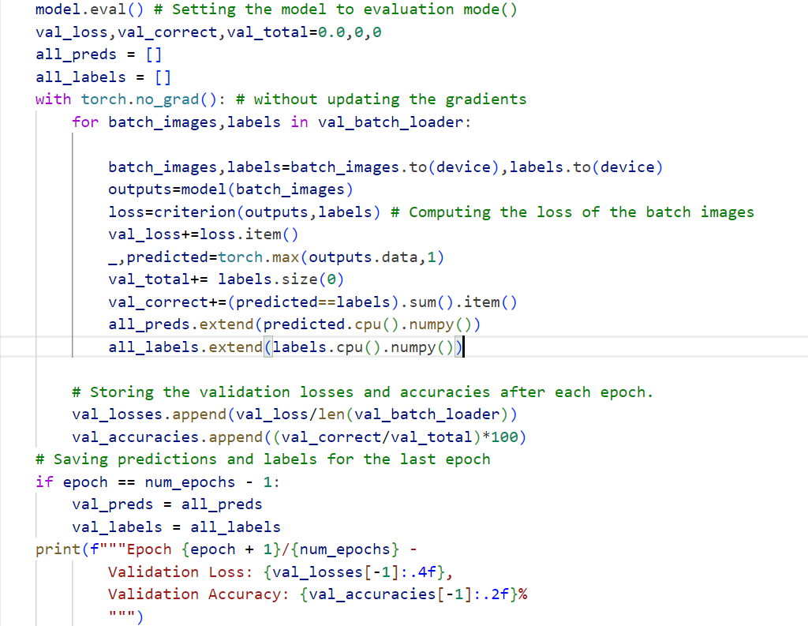
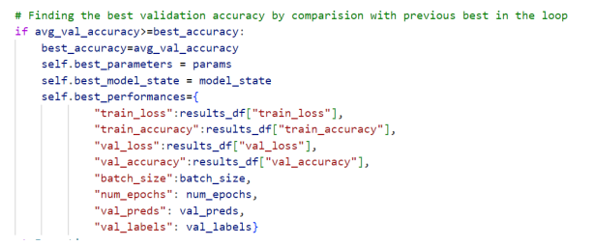
Critical decisions during training for confident predictions
Resnet-50 model is trained on 16 combinations of training data to maximize learning.
During training, torch.no_grad() and model.eval() were used to save the memory usage and speeds up inference since gradients are not needed during validation.
Unlike in the training, Validation doesn’t update the model weights, with the torch.no_grad() and also doesnt dropout neurons nor use batch normalization with model.eval()
During hyperparameter tuning, best validation accuracy was tracked and updated by comparing with the previous best as shown in the Figure.
Normalization on each fold during hyperparameter tuning:
- During hyperparameter tuning the normalization is performed on separately to generate only normalized images with mean and standard deviation of the fold.
Training data is not normalized during preprocessing for same reason.
Figure: Computing validation accuracy during hyperparametertuning
Figure: Condition for computing validation accuracy during k-fold cross validation

Slide 13
Computational resources used for Training
During hyperparametertuning, grid search is chosen as it thoroughly explores all possible combinations, ensuring the best hyperparameters are found.
Learning Rate (0.001, 0.01):
0.001 is chosen for stable convergence; 0.01 for faster training.
Limited walltime (25 hours) and epochs (7–12) favor 0.01 to accelerate convergence.
Optimizers (SGD, Adam):
SGD is considered for its stability with large datasets, while Adam performs well in noisy environments.
Memory allocation(40GB) was allocated to support training with both.
Epochs (7, 12):
Epochs 7 and 12 were chose to balance training efficiency, computational cost and model generalization. 20 Epochs could be beneficial for further optimization.
Batch size(16,32):
A batch size of 32 offers more stable training and requires significant computational memory. While Batch size 32 leads to less stable training.
Hyperparameter tuning | Considered Parameters
Learning Rate (--lr) | 0.001, 0.01
Batch Size (--bs) | 16, 32
Epochs (--epochs) | 7, 12
Optimizer (--optim) | SGD, Adam
Number of k-folds (--k-folds) | 2
Table: variable values for different Grid search hyperparameters during training
Resource | Value
Job ID | 963992.mmaster02
Job Name | Hyperparameter_tuning
Queue | teachingq
Node Count | 1(mfatnode004)
CPU Cores (ncpus) | 1
Memory Requested | 40 GB
Virtual Memory Used | ~35GB (3586004 KB)
Walltime Requested | 35:00:00 (35 hours)
Walltime Used | 32:34:22
Table: Resources and allocated in HPC cluster using PBS job scheduler

Slide 14
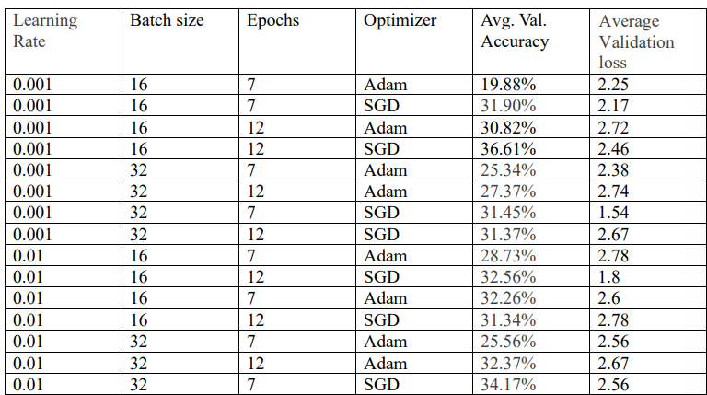
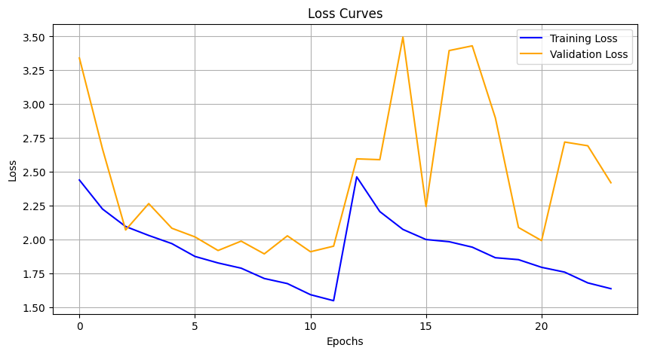
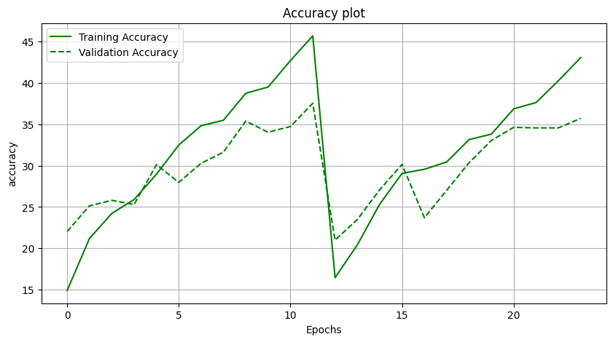
Results: Best hyperparameters for training ResNet-50
After rigorous hyperparametertuning, It can be observed that the combination of SGD optimizer, 16 batch size, and 12 epochs achieved the highest validation accuracy (36.61%).
SGD optimizer performed wellwith high validation accuracies on the data, when compared to Adam as it uses a fixed learning and noiser updates, which acts as implicit generalization.
The noiser updates can also be observed clearly in the validation-loss curve of 2nd fold of the figure, resulting in unstabe loss values.
Though validation-accuracy curve overfits the training data during the initial epochs, after certain epochs the model is generalizing well to attain good bias-variance tradeoff. This indicates no presence of overfitting or underfitting to the data.
Table: Average validation and average validation losses and accuracies of 16 combinations computed after hyperparametertuning
Figure:Training accuracy and validation curves for the best hyperparameter combination on learning_rate=0.001, optimizer=SGD, batch size=16, epochs=12, no.of folds=2. In the plots, epochs from 1 to 12 represent the training accuracy and losses for the 1st fold and epochs from 12 to 24 represents the training accuracy and losses of 2nd fold.

Slide 15
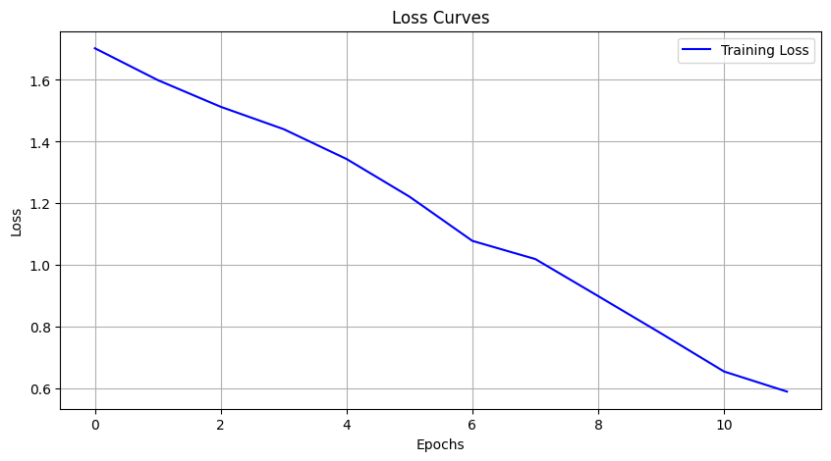
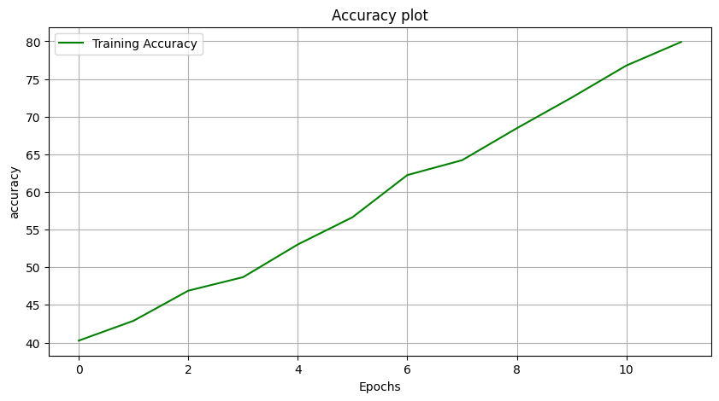
Results: Training the model on entire training data
As the model is being trained on the entire training data, the model is interpreting correct predictions.
This can be observed with decrease in the loss and increase in the accuracy as epochs increase, indicating the updation of weights by SGD optimizer in the direction of minimum loss.
Finally, Resnet-50 model is trained on the entire training data with SGD optimizer and 16 batch size over12 epochs to achieve an accuracy of 79.89% and a loss of ~0.6.
Figure: Loss and accuracy curves after training of ResNet-50 model with
batch size=16, epochs=12 and SGD optimizer

Slide 16
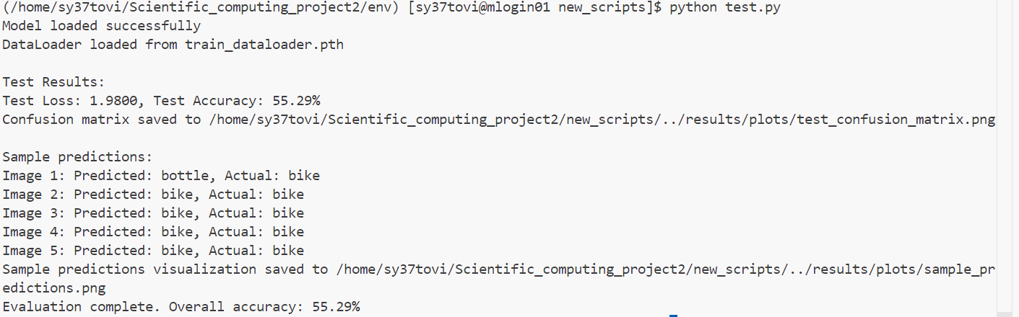
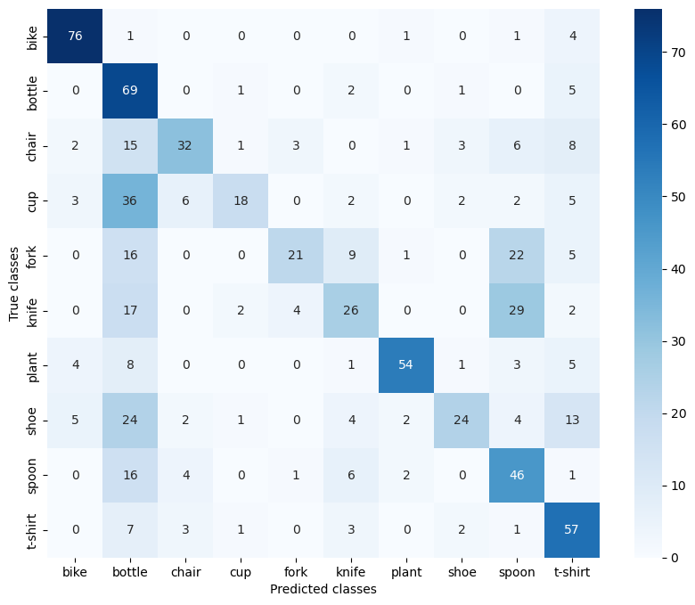
Results: Evaluation of model on test data
The saved model weights are loaded to the model along with the cross entropy loss function.
The loaded Resnet-50 model is evaluated on the unseen test data by fixing the weight parameters.
The model performed moderately good with an accuracy of 55.29% and a loss of 1.98.
It can be observed from confusion matrix that, model performed very good in all other classes, except in bottle, spoon, and t-shirt. So, we need to improve quality of the data in these images/train the model with more images
Figure: Result on test accuracy and on test loss after execution of test.py script
Figure:Confusion matrix of test data indicating the no. of per-class correct and incorrect classifications

Slide 17
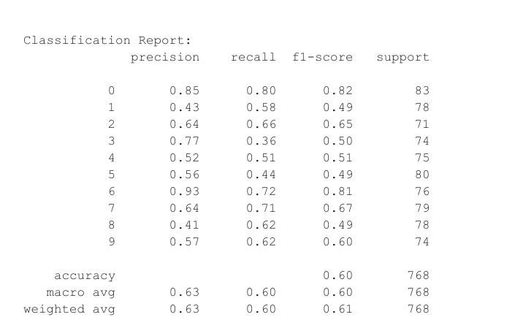
Test Results: Classification Report

Slide 18
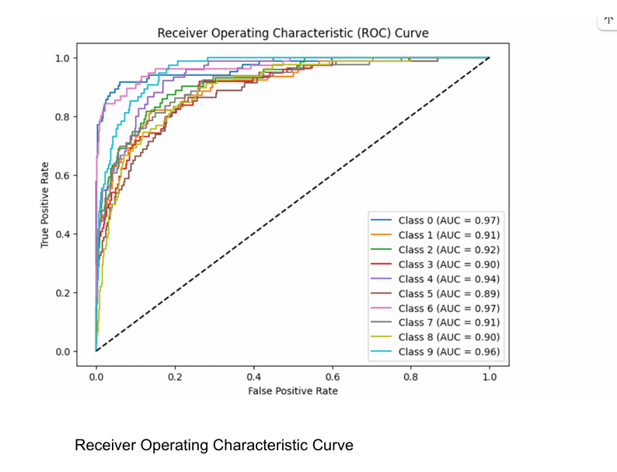
Test Results: ROC Curve

Slide 19
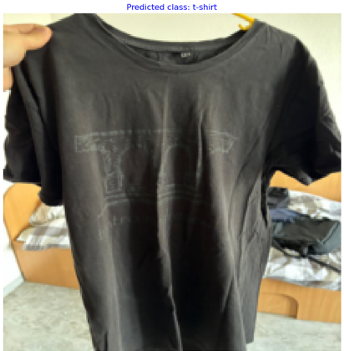
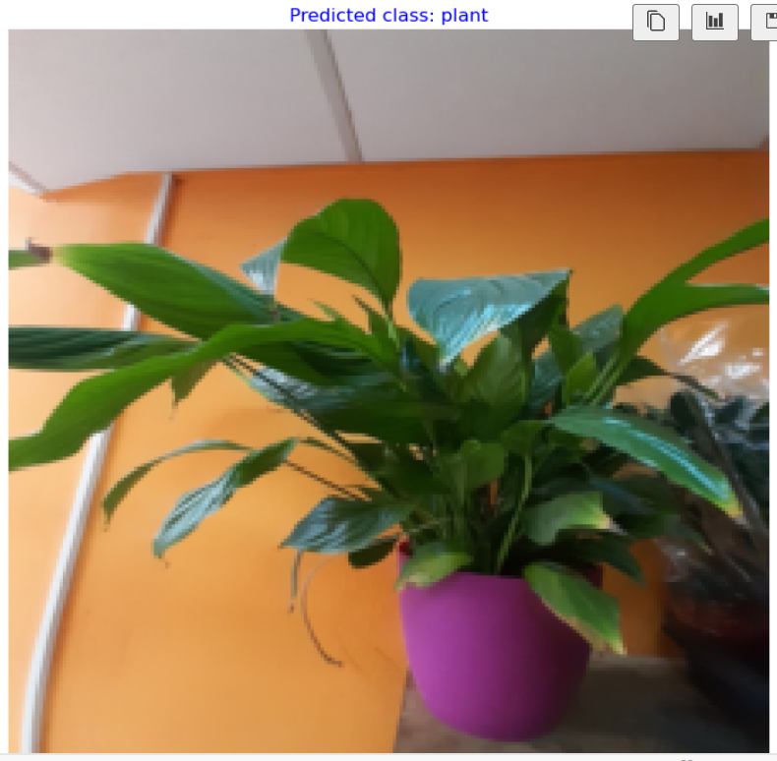
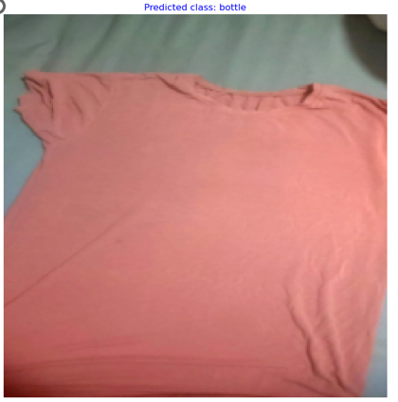
Predicted randomly selected images:

Slide 20
Thank you!

